Slide 1


Introduction to
Robotic Process Automation
ONLINE ATTENDANCE TRACKING SYSTEM
Your Register No:220701006
Name: Abilash.M
Guide Name: J.Jinu sophia
Designation and Department: CSE-A

Slide 2
Abstract
The Online Attendance Tracking System using UiPath RPA is a digital solution that automates the process of recording and managing attendance across various environments, such as educational institutions, workplaces, and events, by leveraging Robotic Process Automation (RPA) with UiPath. Traditional methods of taking attendance, such as manual entry or paper-based systems, are time-consuming and prone to errors. This system addresses these challenges by automating attendance tracking, reducing human intervention, and ensuring accurate, real-time data collection. stakeholders.

Slide 3
Need for the Proposed System
The Online Attendance Tracking System using UiPath RPA is designed to meet the growing demand for efficient, accurate, and scalable attendance management in digital environments. Traditional methods, such as manual sign-ins and spreadsheet tracking, are labor-intensive and prone to human errors.y automating attendance recording, this system improves efficiency, reduces administrative burdens, and ensures precise data collection in real time.

Slide 4
Advantages of the Proposed System
Accuracy: Eliminates human errors and prevents proxy attendance.
Real-Time Tracking: Instant updates on attendance status.
Time Efficiency: Reduces time spent on manual tracking and reporting.
Enhanced Security: Uses biometrics or QR codes to ensure only the correct individual marks attendance.
Reduced Administrative Burden: Automates data collection and reporting.
Scalability: Handles large numbers of users, suitable for schools or organizations.

Slide 5
Literature Survey
Paper 1:Robotic Process Automation for Data Validation in Excel Sheets.
Advantages:Automates repetitive tasks, reduces manual errors, enhances data accuracy
Disadvantages:Limited flexibility for dynamic datasets, high initial setup costs.
Paper 2:Improving data Quality through Automated Error Detection
Advantages:Provides real-time error feedback, supports multiple data formats, scalable for large datasets.
Disadvantages:Requires technical expertise, customization needed for complex datasets.

Slide 6
Main Objective
The main objective of this project is to automate and streamline attendance tracking processes by leveraging UiPath's RPA capabilities. This system aims to accurately capture attendance data in real-time, reducing manual effort and minimizing errors associated with traditional tracking methods. By automating data collection, storage, and report generation, the project enhances efficiency, provides reliable attendance records, and allows organizations to focus more on core activities rather than administrative tasks. This automated system ensures improved accuracy, accessibility, and transparency, making it a practical and scalable solution for modern attendance management.

Slide 7
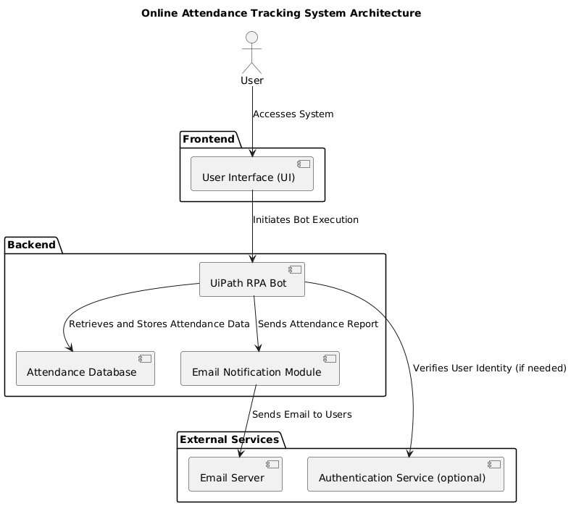
Architecture

Slide 8
System Requirements
Hardware Requirements:
Processor: Intel i5 or higher
RAM: 8 GB or more
Storage: 256 GB SSD (minimum)
Network: Stable internet connection for real-time updates and email dispatch
Display: 1366x768 resolution or higher
Software Requirements:
Operating System: Windows 10 or higher
Automation Tool: UiPath Studio (Community/Enterprise Edition)
Framework: .NET Framework 4.7.2 or higher
Email Services: SMTP server configuration (e.g., Gmail, Outlook)
Excel: Microsoft Excel (2016 or later) or equivalent tool for data processing
Browser: Chrome or Edge with UiPath extensions installed for data scraping.

Slide 9
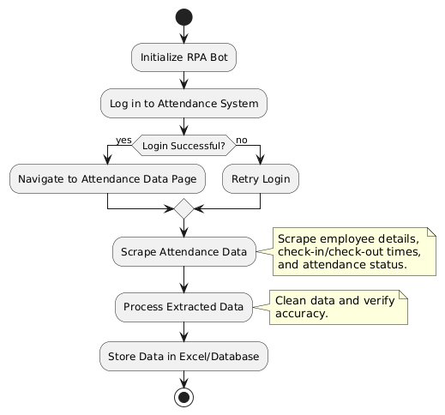
Functional Description
Module 1: Data Extraction Module
This module is responsible for scraping attendance data from the designated source, It then processes and stores this data into an Excel sheet or internal database for further use and reporting.

Slide 10
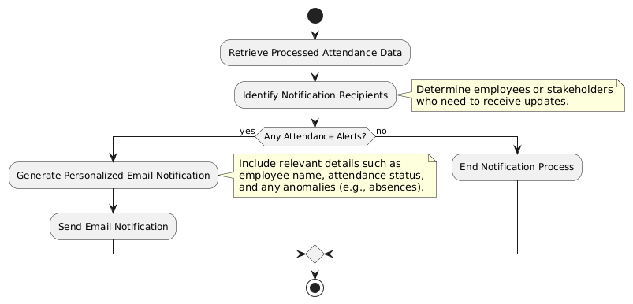
Functional Description
Module 2: Email Notification Module
This module automates the process of sending email notifications to users, containing attendance percentage of thet month.

Slide 11
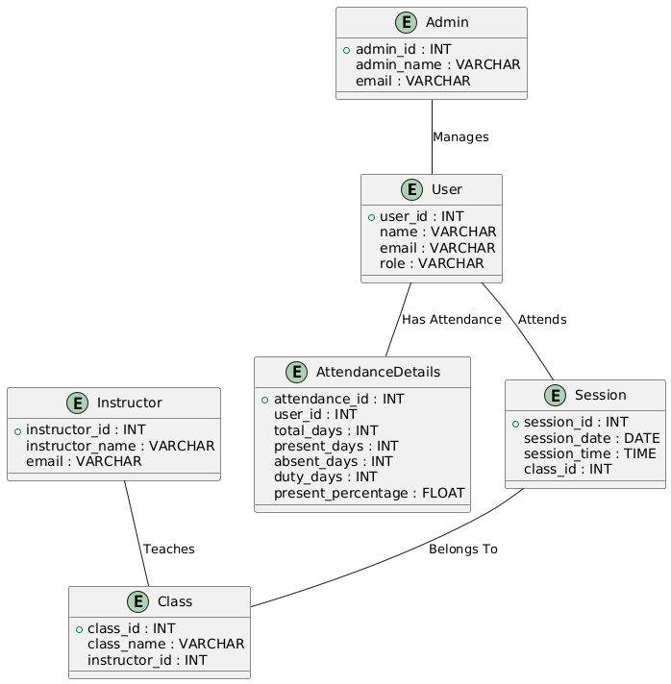
Table Design
ENTITY_RELATIONSHIP DIAGRAM:

Slide 12
Process Design
Main Process:
Fetch and process employee attendance data in real-time. Perform calculations to determine attendance status and store the processed data in an Excel sheet or a database.Sub Processes:
Sub Process 1: Data Extraction: The RPA bot scrapes attendance data from the designated source
Sub Process 2: Email Notifications: Generates and sends email updates to users.
Flow Control:
The main process follows a sequential flow through the above steps, with each sub-process handling specific tasks such as data extraction and notifications
End Process:
The process ends once the email notifications are sent.

Slide 13
Implementation
Module 1: Data Extraction
This module is responsible for extracting attendance data from a specific source (e.g., a web-based system or an internal database). UiPath RPA bots will scrape relevant details like employee IDs, names, timestamps, and attendance status. This data will be processed and stored in an Excel sheet or database for further analysis and record-keeping.
Module 2:Email Notification System
This module manages notifications related to attendance updates. After processing the data from Module 1, the system generates personalized emails or notifications to inform relevant stakeholders about attendance records or specific updates . This ensures timely and automated communication regarding attendance status.

Slide 14
Testing
Testing is a crucial part of the Online Attendance Tracking System project, ensuring that each module functions as intended and delivers accurate results.
Functional Testing: Ensures the RPA bot accurately captures and records attendance data as per the system requirements.
Data Validation Testing: Verifies the accuracy of data entry and data retrieval functions to ensure no loss or corruption.
Load Testing: Tests the system's performance under heavy usage to ensure it can handle multiple concurrent users.
Error Handling Testing: Checks the bot's ability to handle unexpected inputs or system errors gracefully without crashing.

Slide 15
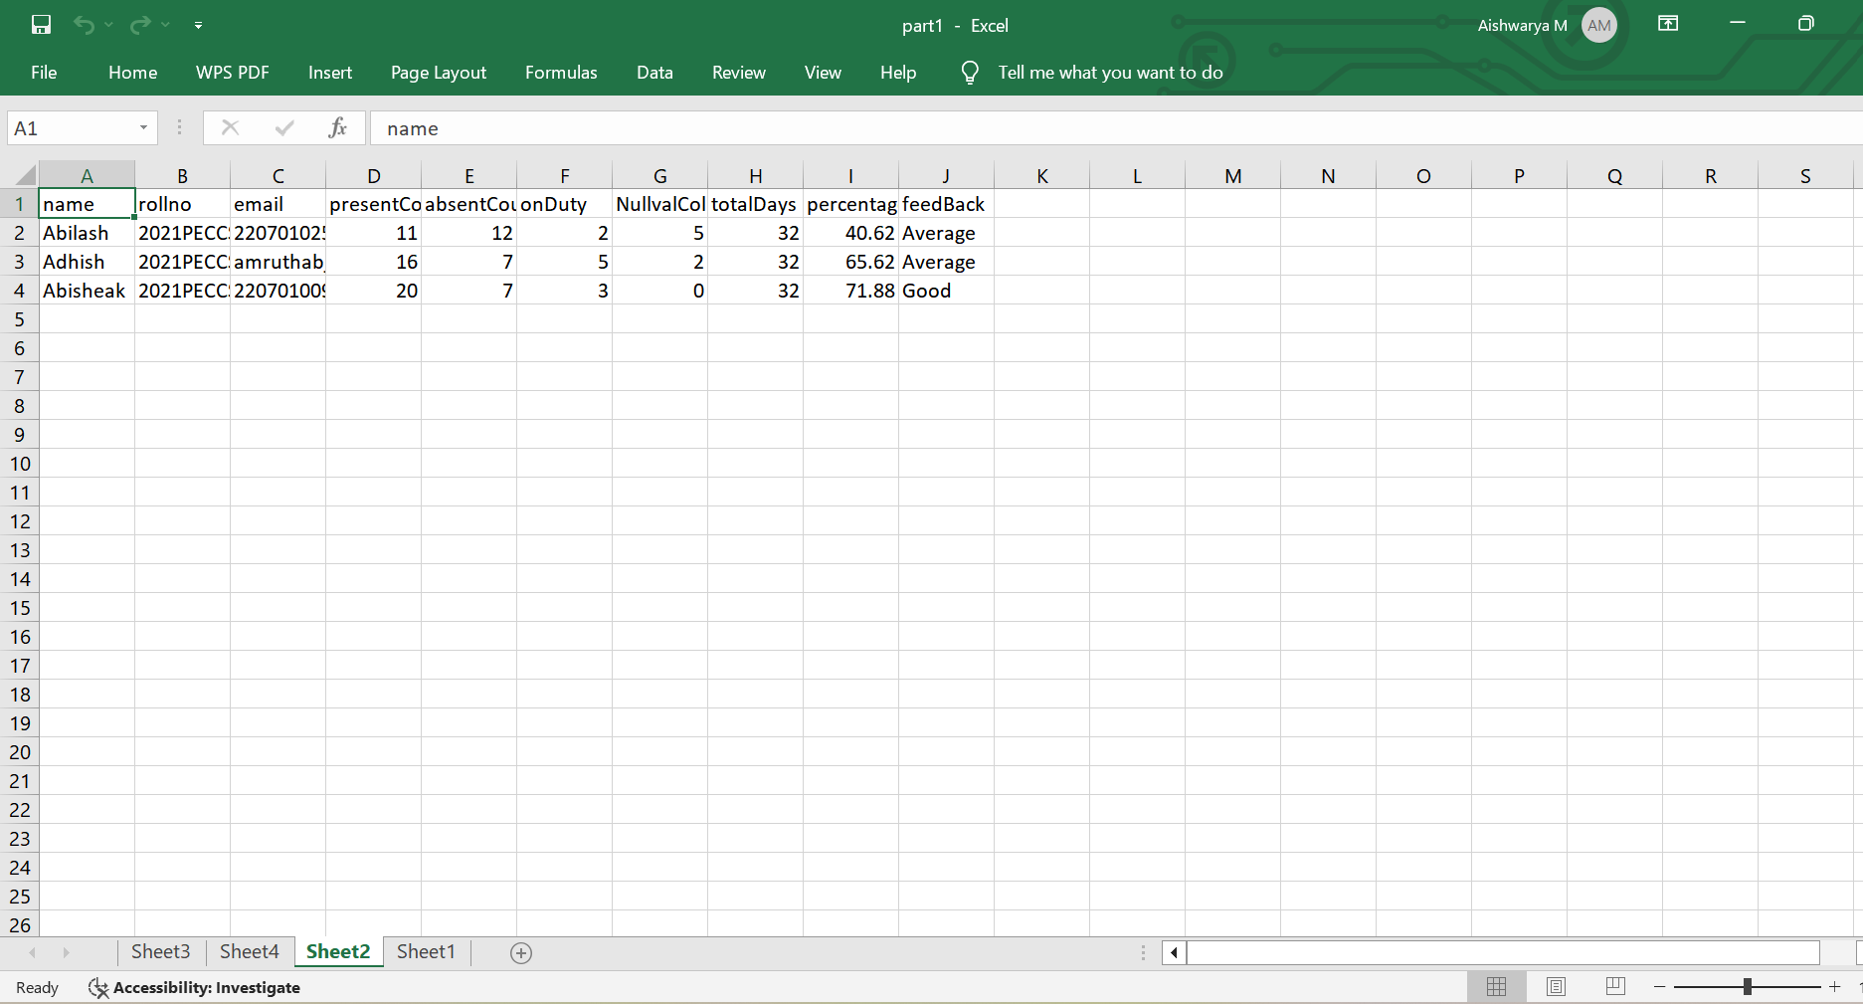
Screenshots

Slide 16
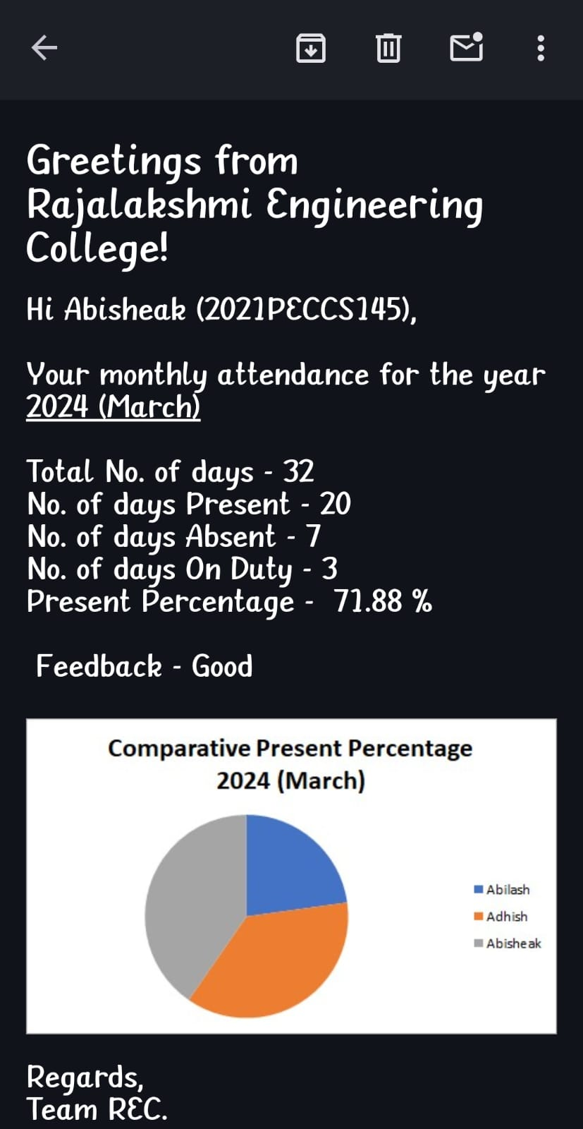
Screenshots

Slide 17
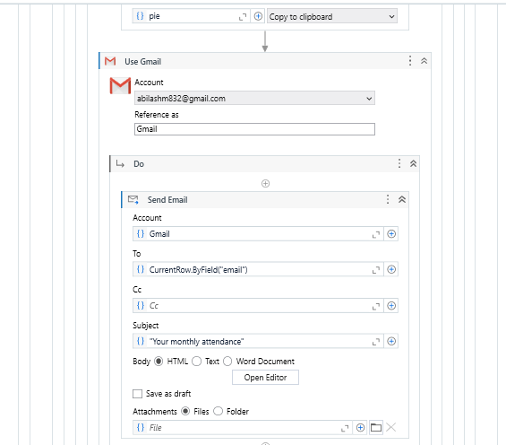
Workflow screenshot

Slide 18
Conclusions
The Online Attendance Tracking System project using UiPath RPA successfully automates the traditional manual process of attendance tracking. By leveraging RPA, the system streamlines attendance data collection, improves accuracy, and ensures real-time updates for better management. The integration of UiPath allows for the automation of data extraction, report generation, and notifications, eliminating the risk of human error while saving time and resources. This system provides a user-friendly interface, making it easy for non-technical users to configure and manage attendance processes.

Slide 19
Future Enhancement
Here are four brief future enhancements for the Online Attendance Tracking System:
1.Real-Time Geo-Tracking: Use GPS to ensure attendance is marked only when users are in the correct location.
2.AI Facial Recognition: Automate attendance using facial recognition to eliminate proxy attendance.
3.Mobile App Integration: Develop a mobile app for users to mark attendance and check reports on the go.
4.LMS Integration: Link the attendance system with Learning Management Systems for seamless course and attendance tracking.

Slide 20
IEEE Paper
IEEE Title: "Design and Implementation of Online Attendance System Using QR Code"
Author(s): K. S. Kumar, S. S. Reddy, 2021
IEEE Title: "Biometric Attendance System for Student Management"
Author(s): R. B. Sharma, P. S. Agarwal, 2020
IEEE Title: "RFID-Based Automated Attendance System"
Author(s): M. Gupta, L. Gupta, 2019

Slide 21
References
Lacity, M. C., & Willcocks, L. P. (2016). A Survey on Robotic Process Automation in Business. Journal of Information Technology, 31(2), 174-183.
Goudar, R. H., & Soni, M. P. (2017). AutomationAvasarala, V. (2019). Robotic Process Automation: The Next Transformation in Digital Transformation. International Journal of Advanced Research in Computer Science, 10(3), 5-12.
Kumar, S., & Kaur, A. (2020). Real-Time Data Scraping and Processing using Robotic Process Automation. International Journal of Innovative Technology and Exploring Engineering, 9(3), 10-14.

Slide 22
Queries

Slide 23
Demonstration

Slide 24
Thank You

